Slide 1
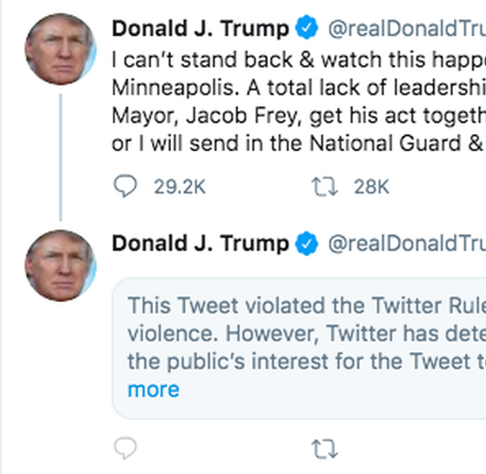
COMP 472 PROJECT 3 Twitter Content Analysis
Janghyuk Boo 40008835
Jixuan Li 40073785

Slide 2

Contributions
Janghyuk: Training Overall Evaluation File
Jixuan: Testing Tracing File
Together: Final Presentation

Slide 3
These elements are irrelevant with the final result, so we removed them before we train the model.
Case variation:
Punctuation:
q2_lable – q7_label
Can / can, COVID / covid
. ? ! :
Irrelevant Features
Data Preprocessing

Slide 4
Naïve Bayes: OV – FV Comparison
Difference between OV and FV? All terms occurs more than twice pass through the filter Single occurrence doesn’t ensure validation of the term
Did the reduction in V lead to a significant diff? Yes
Result
Comparison

Slide 5
Naïve Bayes: OV – FV Comparison
Difference between OV and FV,
what is the size of V
did the reduction in V lead to a significant diff?
compare and contrast the performance of each model with one another
Result
Comparison

Slide 6
LSTM Model Comparison
Result
Comparison

Slide 7
LSTM Model Comparison
Result
Comparison

Slide 8
Overall Comparison
Sample might be too small to produce significant results
Depending on the use case, We should pick different models. for example, If we want to pick up all the fake news, higher recall is preferred. However, If we just want to show reasonable factual news, higher precision is preferred.
Filtered case was better performing than Original BOV
For the LSTM compared to Naive Bayes:
Overall, LSTM is better in most cases.
In both case, No_recall had the lowest score.
better precision for ‘no’ category, implies more results found for ‘valid’ tweets
Result
Comparison

Slide 9

Thank you

